Slide 1
INTRODUCTION TO EMOTIONAL INTELLIGENCE

Slide 2
Agenda
Concept of Emotional Intelligence
What exactly is EQ
Intrapersonal Emotional Intelligence
Interpersonal Emotional Intelligence
How does EQ make a difference in one’s life
Conclusion

Slide 3
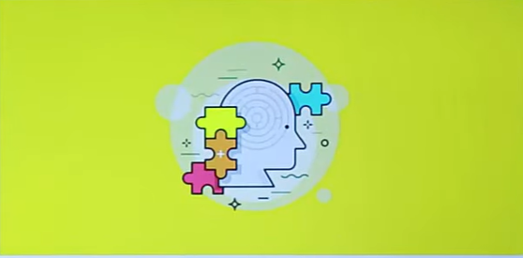
Concept of Emotional Intelligence
Peter Salovey and John D. Mayer coined the terms ‘Emotional Intelligence’ in 1990.

Slide 4
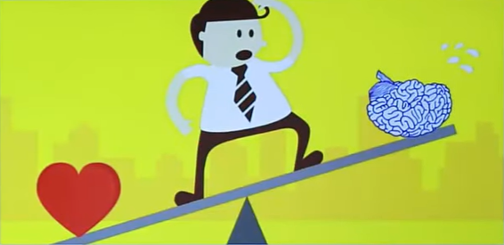
What is Emotional Intelligence?
The capacity to be aware of, control and express one’s emotions, and to handle interpersonal relationships judiciously and empathetically.

Slide 5
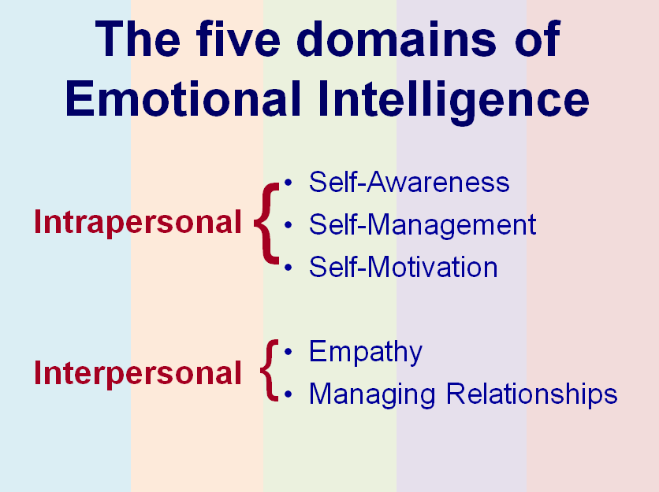

Slide 6
INTRAPERSONAL EMOTIONAL INTELLIGENCE
Intrapersonal emotions means how a person manages his/her emotions internally.
“The emotionally intelligent person is skilled in four areas: identifying emotions, using emotions, understanding emotions, and regulating emotions.”

Slide 7
Intrapersonal Emotional Intelligence
Intrapersonal emotions means how a person manages his/her emotions internally.
“The emotionally intelligent person is skilled in four areas: identifying emotions, using emotions, understanding emotions, and regulating emotions.”
Intrapersonal EQ
Self Awareness
Motivation
Self Regulation

Slide 8
Self Awareness
If you are self aware, you always know, how your feelings, how your emotions ,and how your thoughts can affect the people around you. Being self aware means having a clear picture of your likes ,dislike, strength and weaknesses in your mind.
“self awareness generally means ,behaving with humanity.”
Keep a journal
Slow down

Slide 9
2.Self regulation
people who regulate themselves effectively, rarely verbally attack others, make rushed or emotional decisions ,and always compromises their values.
“self regulating is all about staying in control.”
Know your values
Do you have a clear idea where you will not compromise?
Do you know what values are important to you?
Hold yourself accountable
Practice being calm

Slide 10
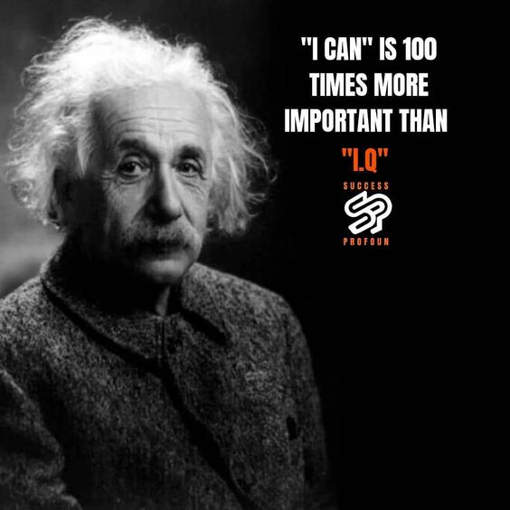
3. Motivation
Self motivated persons work consistently toward their goals ,and in the end by their continuous efforts they clinch their dreams.
“Motivation is all about continuous efforts for dream”.
Know where you stand
Always be optimistic and wish for happiness.

Slide 11
INTERPERSONAL EMOTIONAL INTELLIGENCE
EMPATHY:
“Put yourself in his/her shoes.” That’s what we tell someone when we want them to see things from someone else’s point of view. Empathy is the ability to communicate (send and receive messages) and lead by understanding others’ thoughts, views, and feelings.

Slide 12
The good results of empathy:
stronger, more meaningful relationships.
success in the workplace.
better health and quality of life.
Negative results of lack of empathy:
Scientists have linked the lack of empathy to criminal behaviors such as stealing, drug dealing, and murder.

Slide 13
Managing Relationships:
“using your awareness of your own emotions and those of others to manage interactions successfully”.
Managing personal relationships can be enhanced through emotional intelligence. Evidence suggests that people with higher levels of emotional intelligence lead more successful careers and nurture better relationships than those with low emotional intelligence.

Slide 14

Tips to increase relationship management:
Enhance your natural communication style.
Be proactive with the inevitable.
Acknowledge where the person is.
Build trust.

Slide 15
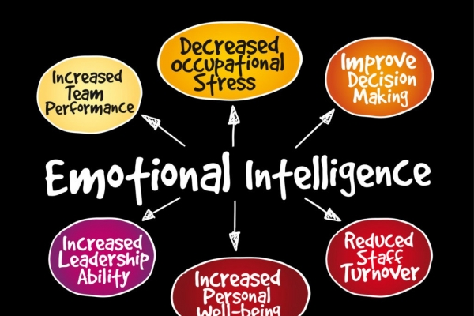
How does EQ make a differennce in one’s life

Slide 16
How EQ makes a difference in one’s life
Better Work Environment
To maintain and display compassion for fellow humans.
Improve Self Motivation
Work towards a cause.
Stress Management
EQ can assist you in managing stress, building strong relationship, empathizing with others, and achieving goals.
Don’t compare yourself to others.

Slide 17
How does EQ make a difference in one’s life
Better Work Environment :
Nowadays ,Many employers look for emotional intelligence in their employees . It results in better Team work as the team members are comfortable in sharing their views and ideas with each other .
The employees with a higher EQ are more likely to trust their coworkers and appreciate their input ,this is an ideal situation for an employer

Slide 18
How does EQ makes a difference in one’s life
Improves Self motivation :
Emotionally intelligent individuals are more likely to be optimistic and goal oriented . Whether personal or professional , these individuals remain determined regardless of the obstacles they face .
These individuals do not depend on external factors ( like fame or money ) to stay motivated ,instead they have a passion to fulfill their own needs and goals .

Slide 19
How does EQ makes a difference in one’s life
Stress Management :
As we already know , the people with high emotional intelligence are able to organize and manage their emotions . This helps them to make rational decisions about personal and professional matters ,hence they are not controlled by stress and other problems .
These individuals are aware of the stress factor and its root cause,hence they manage stress easily .

Slide 20
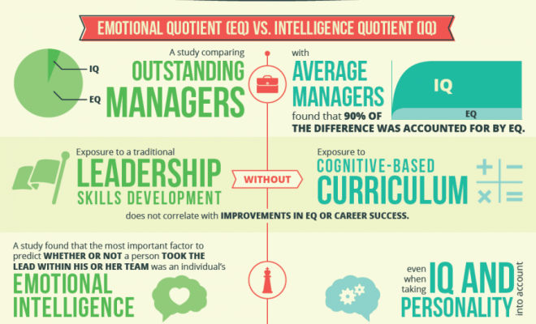
Why EQ is better than IQ ?

Slide 21
Conclusion
“How can we teach EQ to our next generation” ?
Implement Emotional education in school.
Benefits:
Mutual understanding
Acceptance
Tolerance
Connection

Slide 22
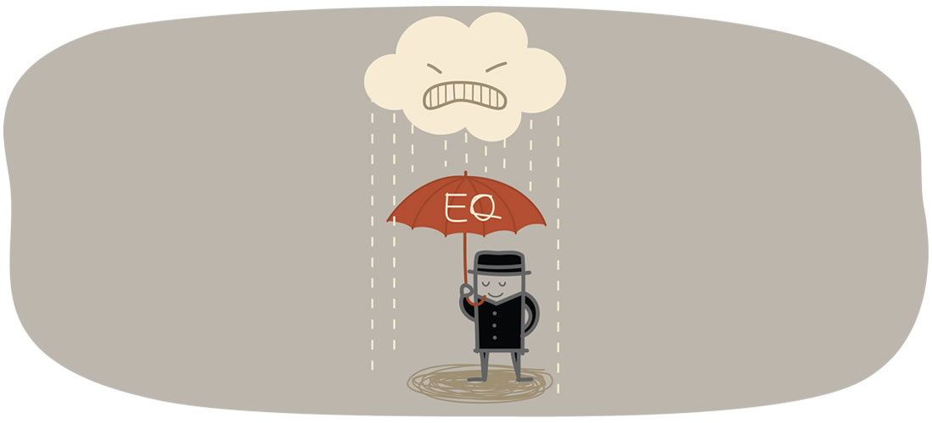
ACTIVITY
How many of you consider yourself an emotionally intelligent person?

